Slide 1
Building an AWS Web App with Serverless Architecture & IAC
Kota Yasushma

Slide 2

Agenda
Abstract
Requirements

Slide 3
In this demonstration, I showcase the power of serverless architecture by building a fully functional web application on the AWS platform. Leveraging the capabilities of AWS Lambda, DynamoDB, API Gateway,S3 and IAM, I have created a scalable and efficient application infrastructure. What's more, I have automated the deployment and management of these resources using Terraform and Ansible, with the added convenience of working within the Windows Subsystem for Linux (WSL) environment.

Slide 4
requirements
Ansible
Terraform
WSL(Windows subsystem Linux)
Windows(local machine)
AWS

Slide 5
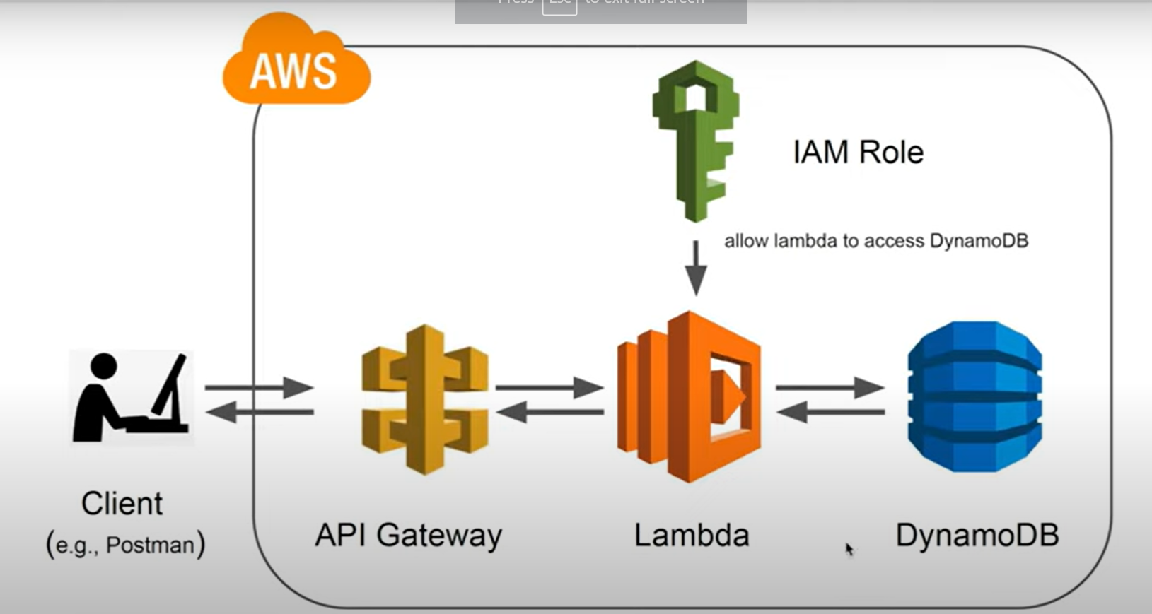
serverless

Slide 6
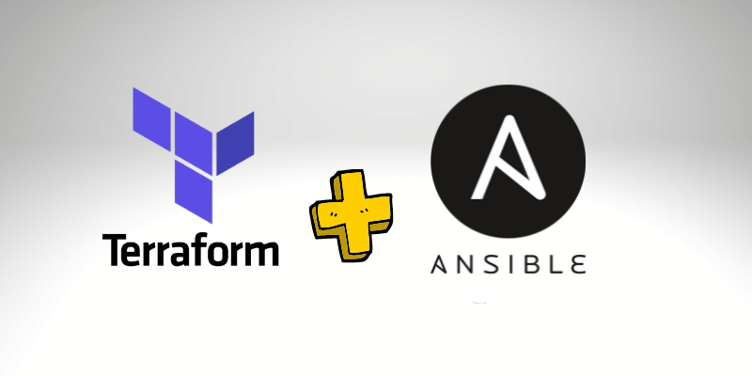
How It works

Slide 7
Implementation
NICHE MARKETS
SUPPLY CHAINS

Slide 8
THANK YOU
Kota yasushma

